Slide 1




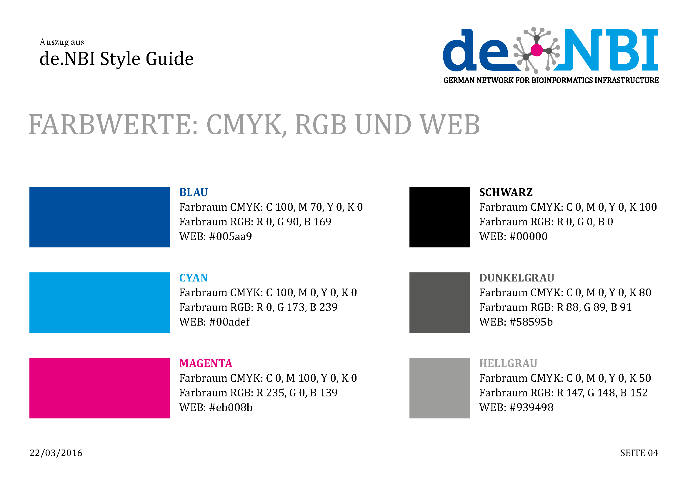





de.NBI − German Network for Bioinformatics Infrastructure
BiGi
Bioinformatics Services for Microbial Genome and Metagenome Research
at the Center for Biotechnology
Firstname Name, Firstname Name, Firstname Name, Firstname Name, Firstname Name, Firstname Name, Firstname Name
Center for Biotechnology, Bielefeld University, Germany
Short description of the project
de.NBI services
Hinweis:
Description of de.NBI services offered and carried out by the project
Progress report
de. NBI training and education
Tasks performed up to October 2016 and planned for the next 12 months
Description of de.NBI training and education activities offered and carried out
Publications
(If applicable)
Förderkennzeichen Nr…..
http://www.denbi.de

